Slide 1

tulsi

Slide 2
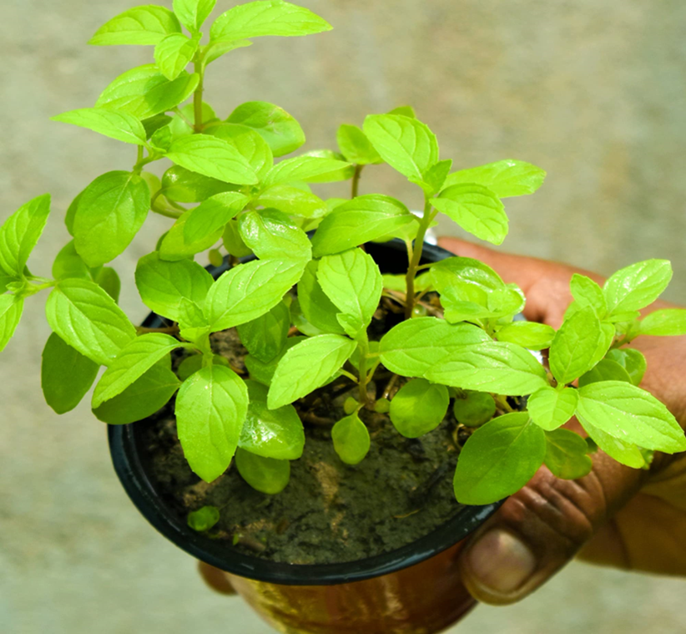
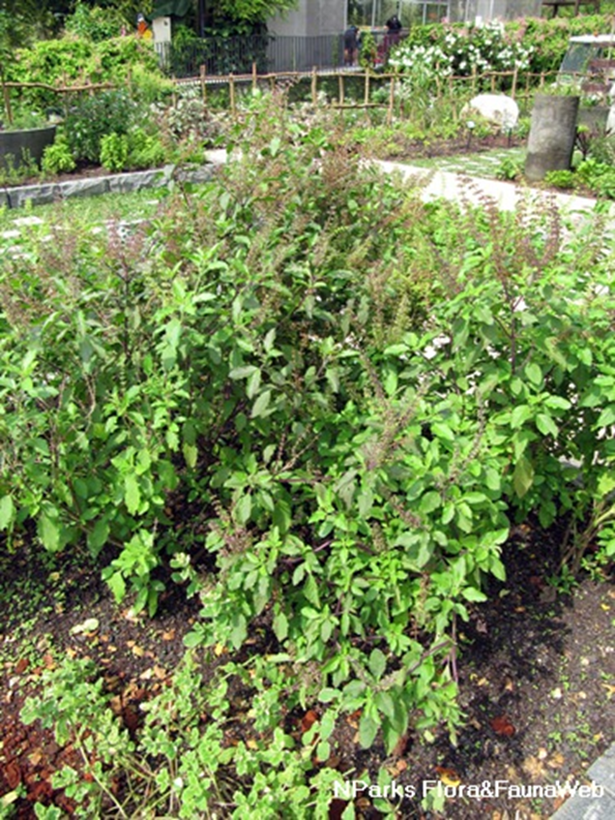

Slide 3
Common Name : Tulsi
Scientific Name : Ocimum tenuiflorum.
Family : Lamiaceae ..
Habit : It is also grown as temperate climates, the natural habitat
of tulsi varies from sea level to an altitude of 2000 m.
It grows naturally in moist soil all over the globe. This plant
is also grown as a pot herb and in home gardens.
Distribution : It is native to tropical and subtropical regions of Australia,
Malesia, Asia, and the western Pacific. It is widely cultivated
throughout the Southeast Asian tropics. This plant has escaped
from cultivation and has naturalized in many tropical regions
of the Americas.

Slide 4
Description :
Height of Tree : upto 1 m (3.3 feet).
Leaves : Leaves are green or purple; they are simple, petioled, with an ovate blade up to
5 cm (2 in) long,which usually has a slightly toothed margin.
Flower: It produces small, aromatic flowers that are typically purple or white.
Fruits: The fruit is composed of 4 tiny, one-seeded nutlets. The fruits are nutlets and produce numerous seeds.
Stem of the tree : The stems are hairy and bear simple toothed or entire leaves oppositely along the stem.
Seeds : Tulsi seeds germinate easily. The seeds are sown in the motherbed. They are watered from time
to time and germinated in one to two weeks. Tulsi prefers rich soil for its growth.

Slide 5
Stem of the tree : The stems are hairy and bear simple toothed or entire leaves oppositely along the stem.
Seeds : Tulsi seeds germinate easily. The seeds are sown in the motherbed. They are watered from time to time and germinated in one to two weeks. Tulsi prefers rich soil for its growth.
The three main morphotypes cultivated in India and Nepal are Ram tulsi (the most common type, with broad bright green leaves that are slightly sweet), the less common purplish green-leaved (Krishna or Shyam tulsi) and the common wild vana tulsi

Slide 6
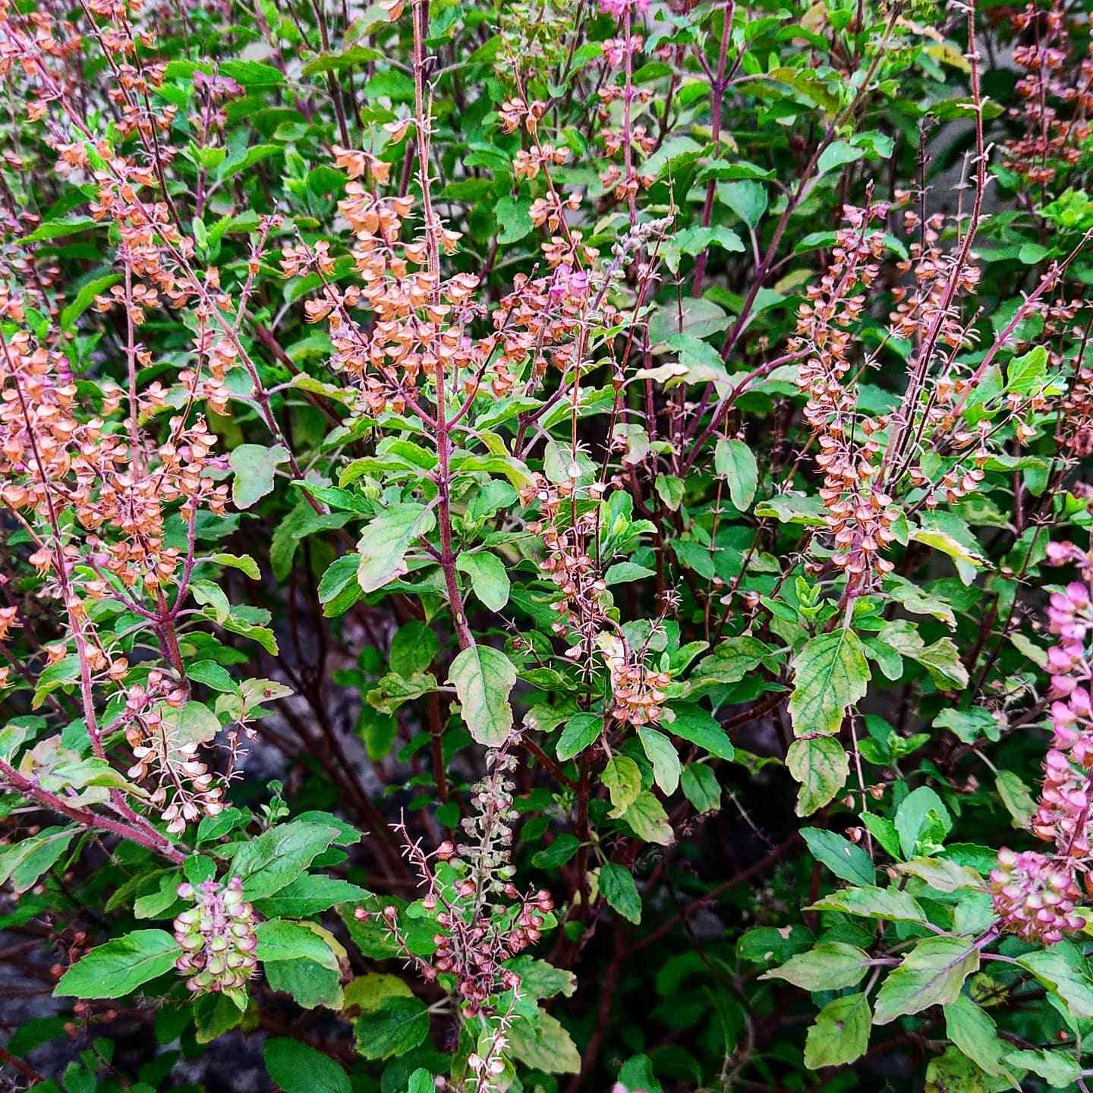
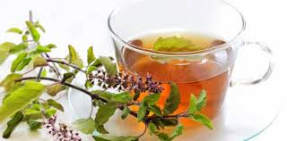
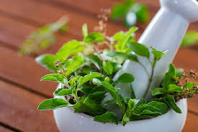
USES

Slide 7
Leaves: Tulsi is used to treat insect bites. Tulsi is also used to treat heart disease and fever. Tulsi is also used to treat respiratory problems. Tulsi is used to cure fever, common cold and sore throat, headaches and kidney stones. The dried leaves have been mixed with stored grains to repel insects.
Seeds: the seeds of the Tulsi fruit can be used for various purposes, such as promoting digestive health, aiding in respiratory conditions, and providing nutrient-rich properties. The seeds are also known to be beneficial for hydration and cooling the body in hot climates.
Stem: It can be used to make herbal decoctions and teas, which are believed to possess several health benefits, including antioxidant properties, and support for respiratory health. In Ayurveda, the stem is sometimes incorporated into daily rituals for its spiritual significance, and it can also be used in natural remedies for minor ailments.

Slide 8

Tulsi is a sacred plant for Hindus.
Prayer beads are made from Tulsi wood.

